Slide 1
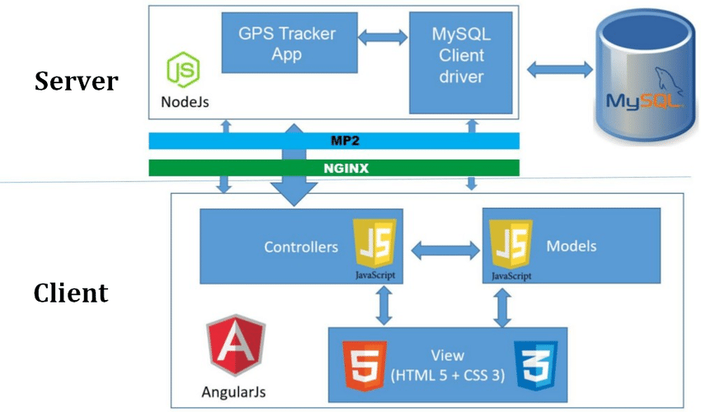
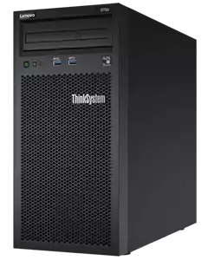


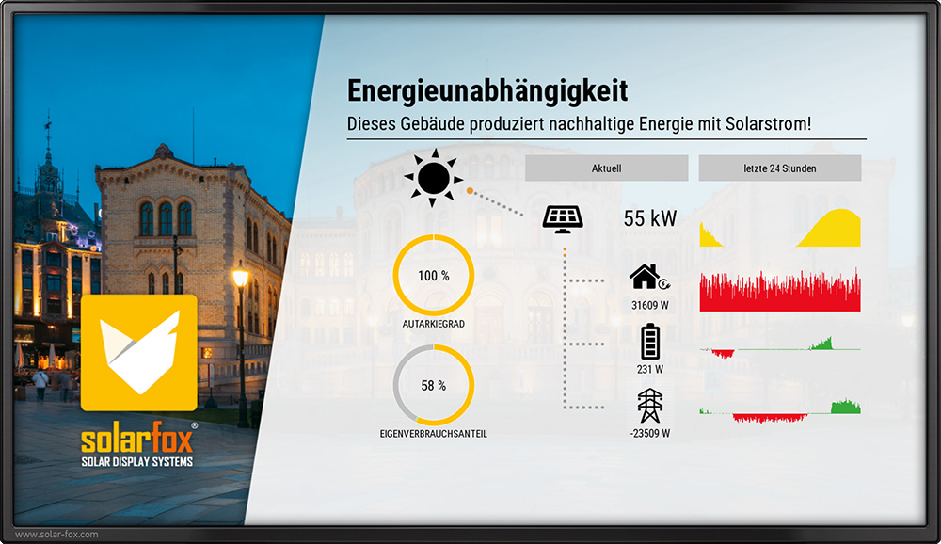



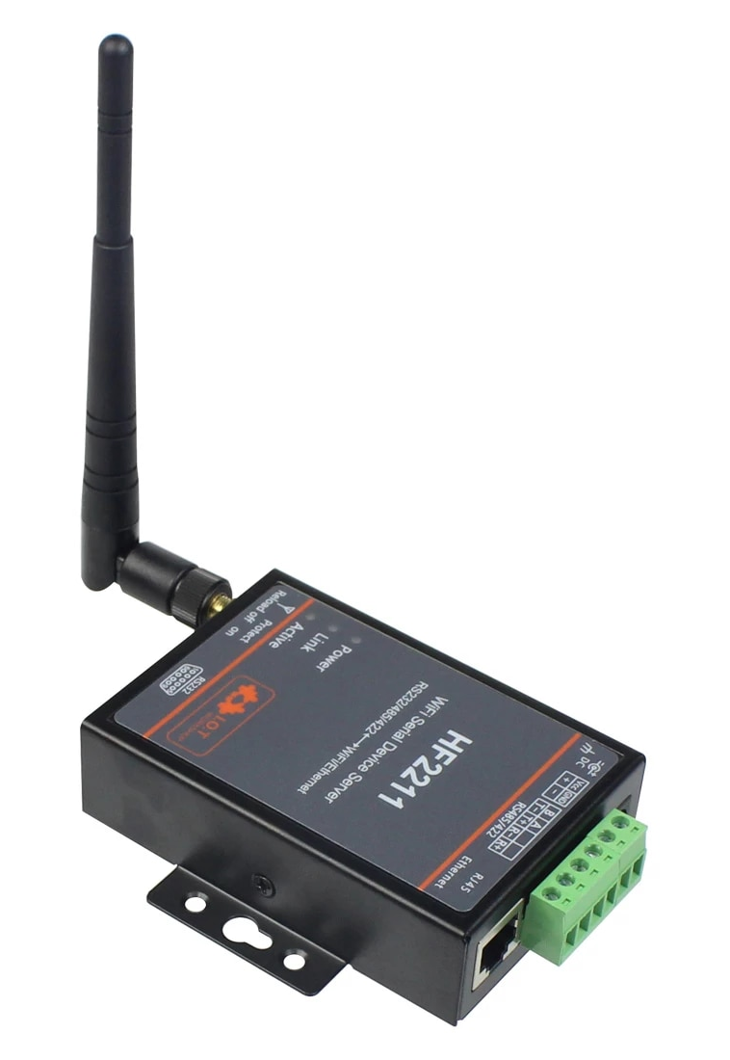
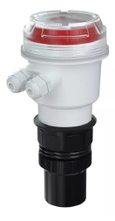
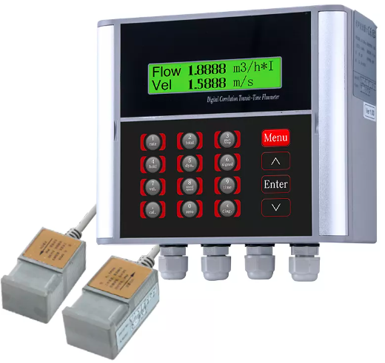
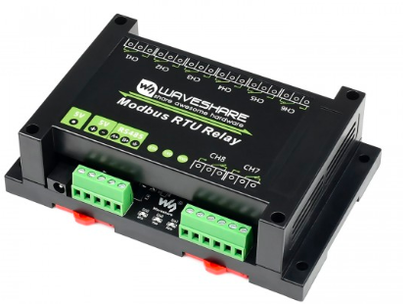
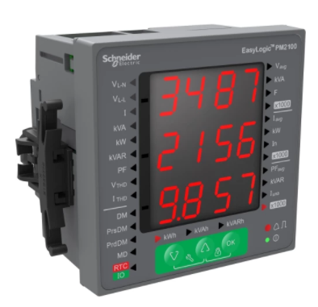
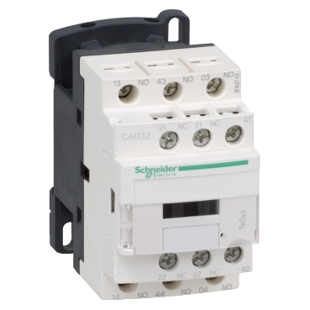
Desain Instrumentasi Akuisisi Data – IoT Architecture Framework
Server
Data Base
Client
Query
Real Time Monitoring
Data
Response
Aplication Layer
(VM Server)
TCP/IP
Modbus Gateway
RS485 to TCP
Network Layer
(Router, Switch & Gateway)
Modbus
RS485
Modbus
RS485
Modbus
RS485
Modbus
RS485
Perception Layer
(Sensor & Actuator)
Modbus RTU
Relay
Digital Power Meter PM 2300
Ultrasonic Level Meter
SUP-MP-C
Ultrasonic Flow Meter
SUP-1158J
Contact Relay
Pump (Load)

Slide 2



Data Understanding
PV Module 210 Wp
AC
DC
AC Load
lnverter
R
DC Load
Buck – Boost Converter
DC
DC
Bidrectional Converter
Protection Device
Main Component
IoT Device
Battery System
Controller Device

